Slide 1
SIMPLE GENETIC ALGORITHM
Applied to Benchmark Objective Functions
Alex Lau, Tatiana Olenciuc, Pranav Patel, Adam Scott, Saitan Taneja

Slide 2
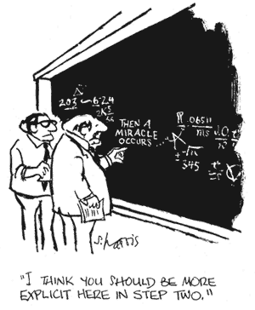
What IS The Simple GEnetic ALGORITHM?
Problem: We are given a black-box objective function, F.
Black-box means that solutions for valid inputs are computable, but the mechanism is unknown).
An input is a binary encoding of some point in the domain of F.
Goal: Find the input(s) that maximize/minimize the objective function.

Slide 3
How does SGA solve a problem?
Find a method of binary encoding that can represent this problem.
ex: n-queens, each queen has n possible squares (fix a dimension). n² possible configurations, can be enumerated as binary numbers.
Objective function = num conflicts (min).
Generate a random population of binary vectors.
From the current population, generate the new population.
Next generation should be closer to solution than last.
Uses computationally simple/trivial operations.
Animation Credit: Ying-Hong Liao and Chuen-Tsai Sun, An Educational Genetic Algorithms Learning Tool, https://www.ewh.ieee.org/soc/es/May2001/14/Begin.htm

Slide 4
GEtting from one generation to the Next
Reproduction
Select members of this generation to become parents to the next.
Individuals with better OF values have a better chance (biased roulette).
Crossover
Split and match pairs at crossover site.
ex: A = 10001, B = 11110, crossover = 3. Members of new gen: X = 10010, Y = 11101.
Mutation
With certain probability, flip one random bit of members of the new generation.
Good mutations should tend to perform better in the next reproduction phase.
}
Repeat
Repeat this process until we reach a minimum/maximum of the OF.
Return the best input vector we found.
This input vector maximizes or minimizes the objective function.
We found a maximum or minimum of F without knowing what F was!

Slide 5
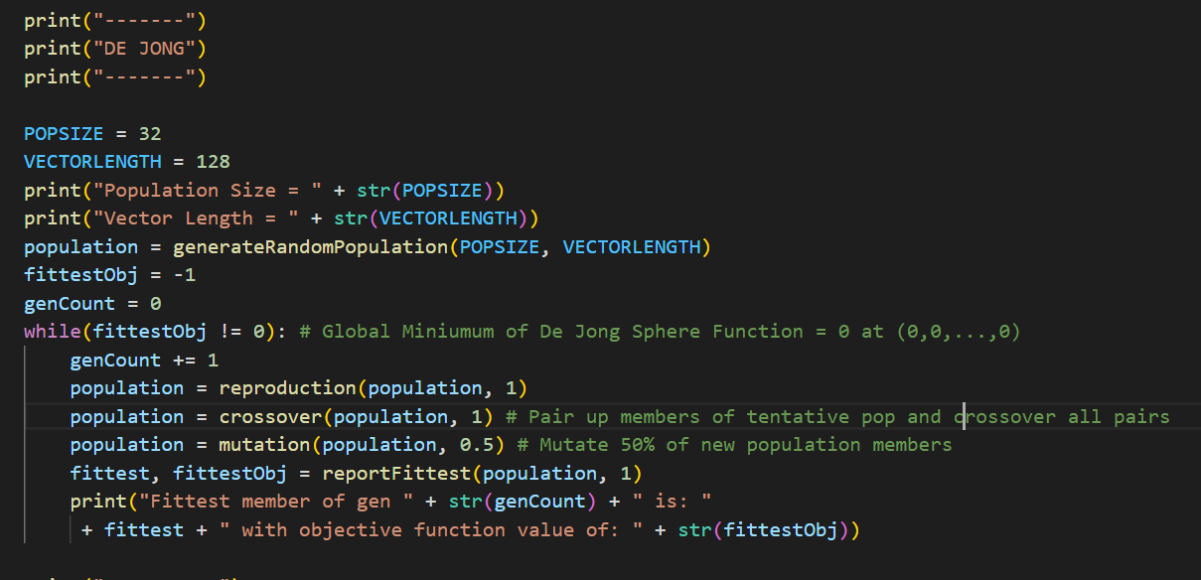
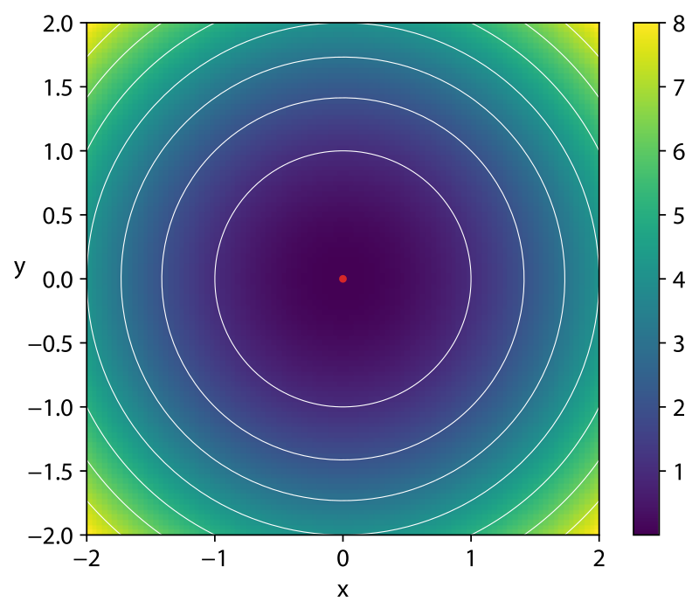
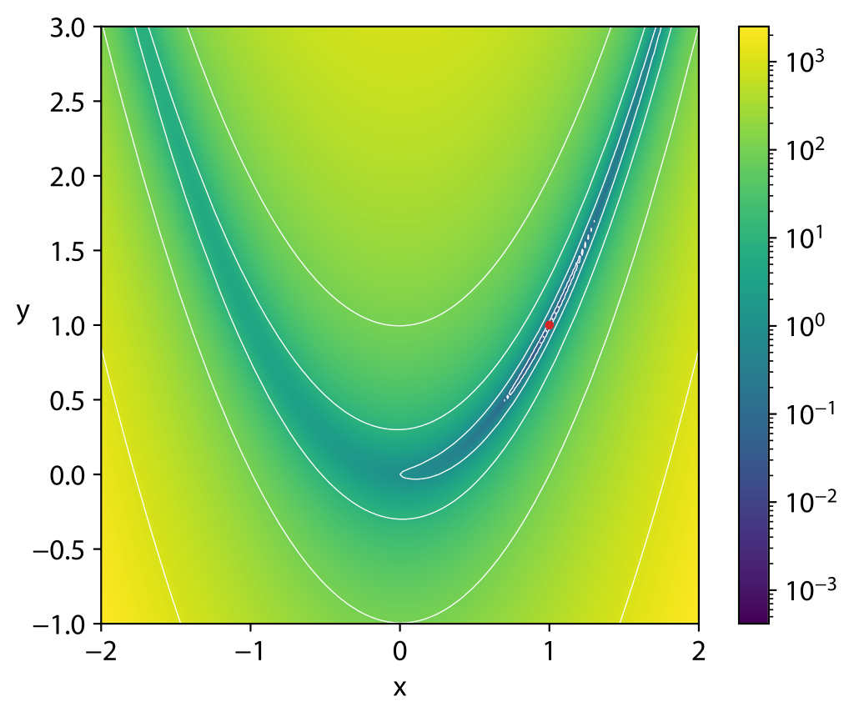
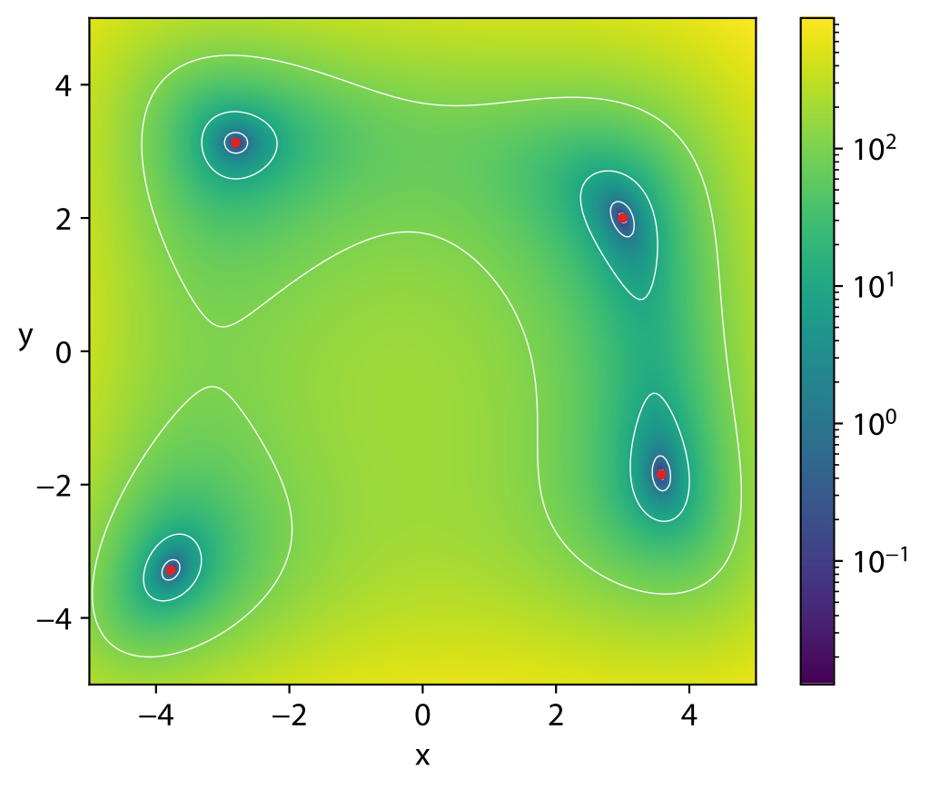
Our Implementation
Screenshot of our code.
Plots of Objective Functions taken from Wikipedia
https://en.wikipedia.org/wiki/Test_functions_for_optimization

Slide 6

Thanks For Listening!
Any Questions?
Presentation template from:

